Slide 1
Machine Learning – Basic Concepts
Praise Ekeopara, ML Engineer @Techpet Global Ltd.

Slide 2

Contents
Introduction – The big picture
Categories of Machine learning
Machine learning workflow
Technical Skills applied in machine learning
Machine learning Architectures (Azure, GCP, AWS)
Applications of Machine learning
How to apply ML in specific fields
Terminologies – Use cases
Q & A

Slide 3

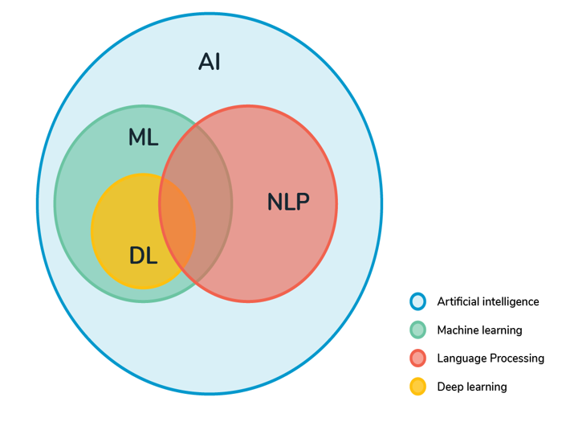
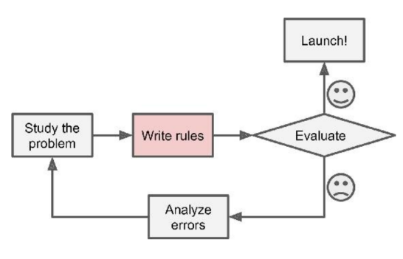
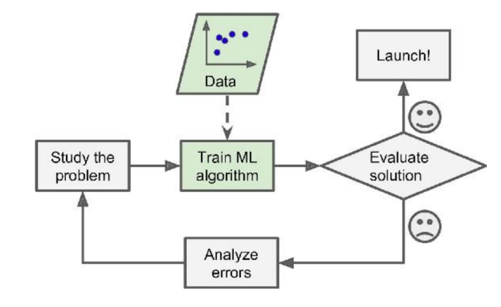
Introduction – The big picture
What is Machine Learning?
A branch of Artificial Intelligence (A.I), where computers (machines) are trained to solve problems by using examples of real-world data without being explicitly programmed to do so.
A. Traditional approach – writing programs
B. Machine Learning approach – learning from data

Slide 4
Categories of Machine Learning
Machine Learning
Machine Learning
Supervised
Unsupervised
Regression
Classification
Clustering Analysis
Dimensionality Reduction
Linear regression
Ridge regression
SVM regression
NN regression
Decision tree regression etc.
Random Forest Classifier
Ridge regression Classifier
SVM Classifier
NN Classifier
DT Classifier etc.
K-means
Affinity propagation
Mean-shift
Spectral clustering
Hierarchical clustering etc.
PCA
ICA
Dictionary learning
Factor Analysis
t-SNE etc.
Note: There are other categories of Machine learning, however we will be limited to these two for simplicity purposes.

Slide 5
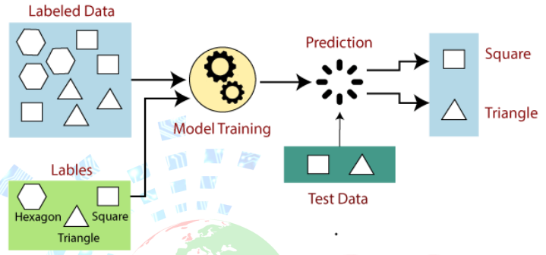
Supervised Learning
The model trains and learns with labeled data

Slide 6
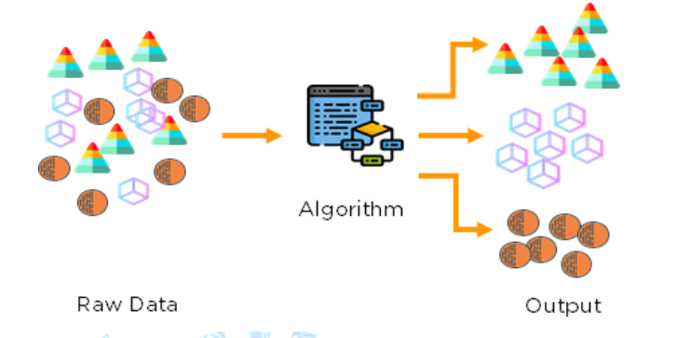
Unsupervised Learning
The model trains and learns with unlabeled data

Slide 7
Machine Learning Workflow
Problem understanding
Problem understanding
Gather data
Monitor and Maintain model
Clean & Explore
Deploy model into production
Prepare & Transform
Validate & Evaluate Model
Develop & Train model
Develop & Train model

Slide 8

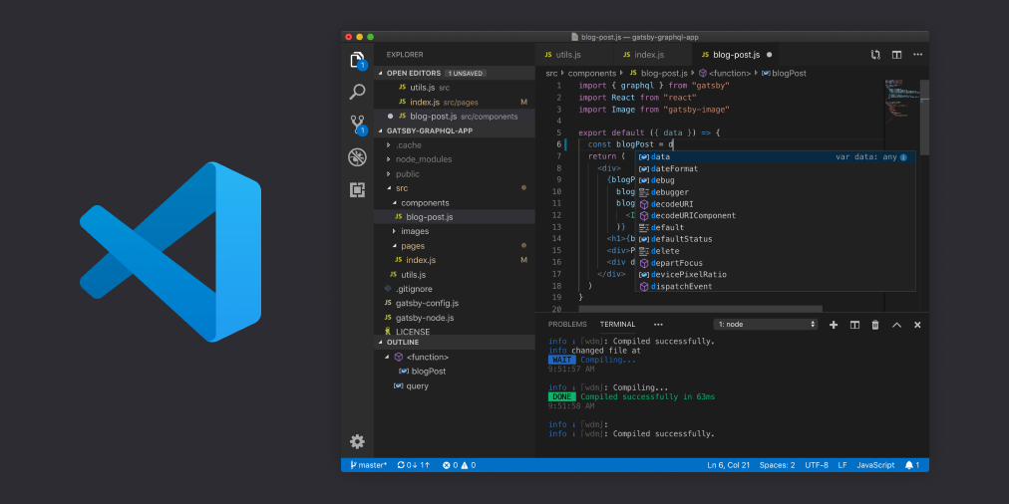



ML Practical Workflow
Coding and Analysis
Code Modularization
Loading into Containers
Building an API
Web framework for interaction

Slide 9
Technical Skills applied in Machine learning
1. Mathematics & Statistics
2. Domain Knowledge
Calculus, Probability, Linear Algebra, Descriptive statistics, Inferential Statistics etc.
Marketing, Healthcare, Automobile, Energy, Finance, Banking, Transportation etc.
4. Software Engineering
3. Programming Skills
API design, System designs, Computer Science, etc.
Python, R, C++, Java, React.js, Html, CSS, Flutter, Kotlin etc.
5. Data Modelling
6. Database Skills
Strong model understanding and best use-cases
SQL (PostgreSQL), NoSQL (MongoDB) etc.
7. ML Libraries
8. Cloud computing
API packages, Sklearn, Pytoch, Tensorflow, Apache, Spark etc.
Virtualization, IaaS, PaaS, SaaS services [AWS, GCP & Azure, IBM etc.)

Slide 10
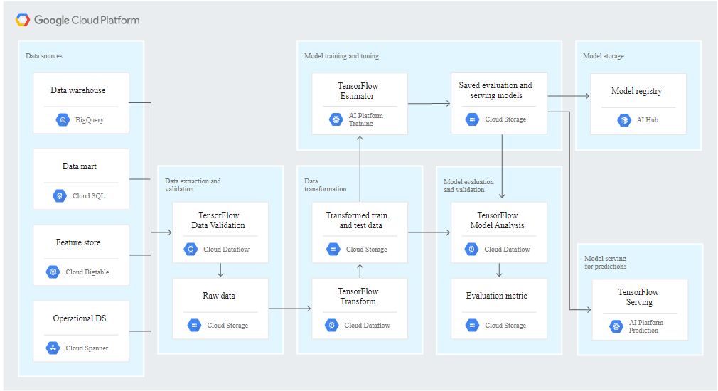
Machine Learning Architecture - GCP
Architecture MLOPs for GCP

Slide 11
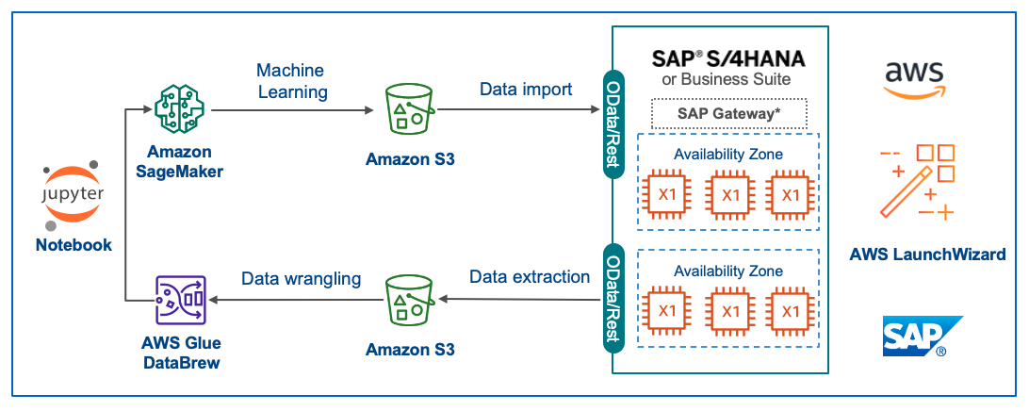
Machine Learning Architecture - AWS
AWS Model Training Architecture

Slide 12
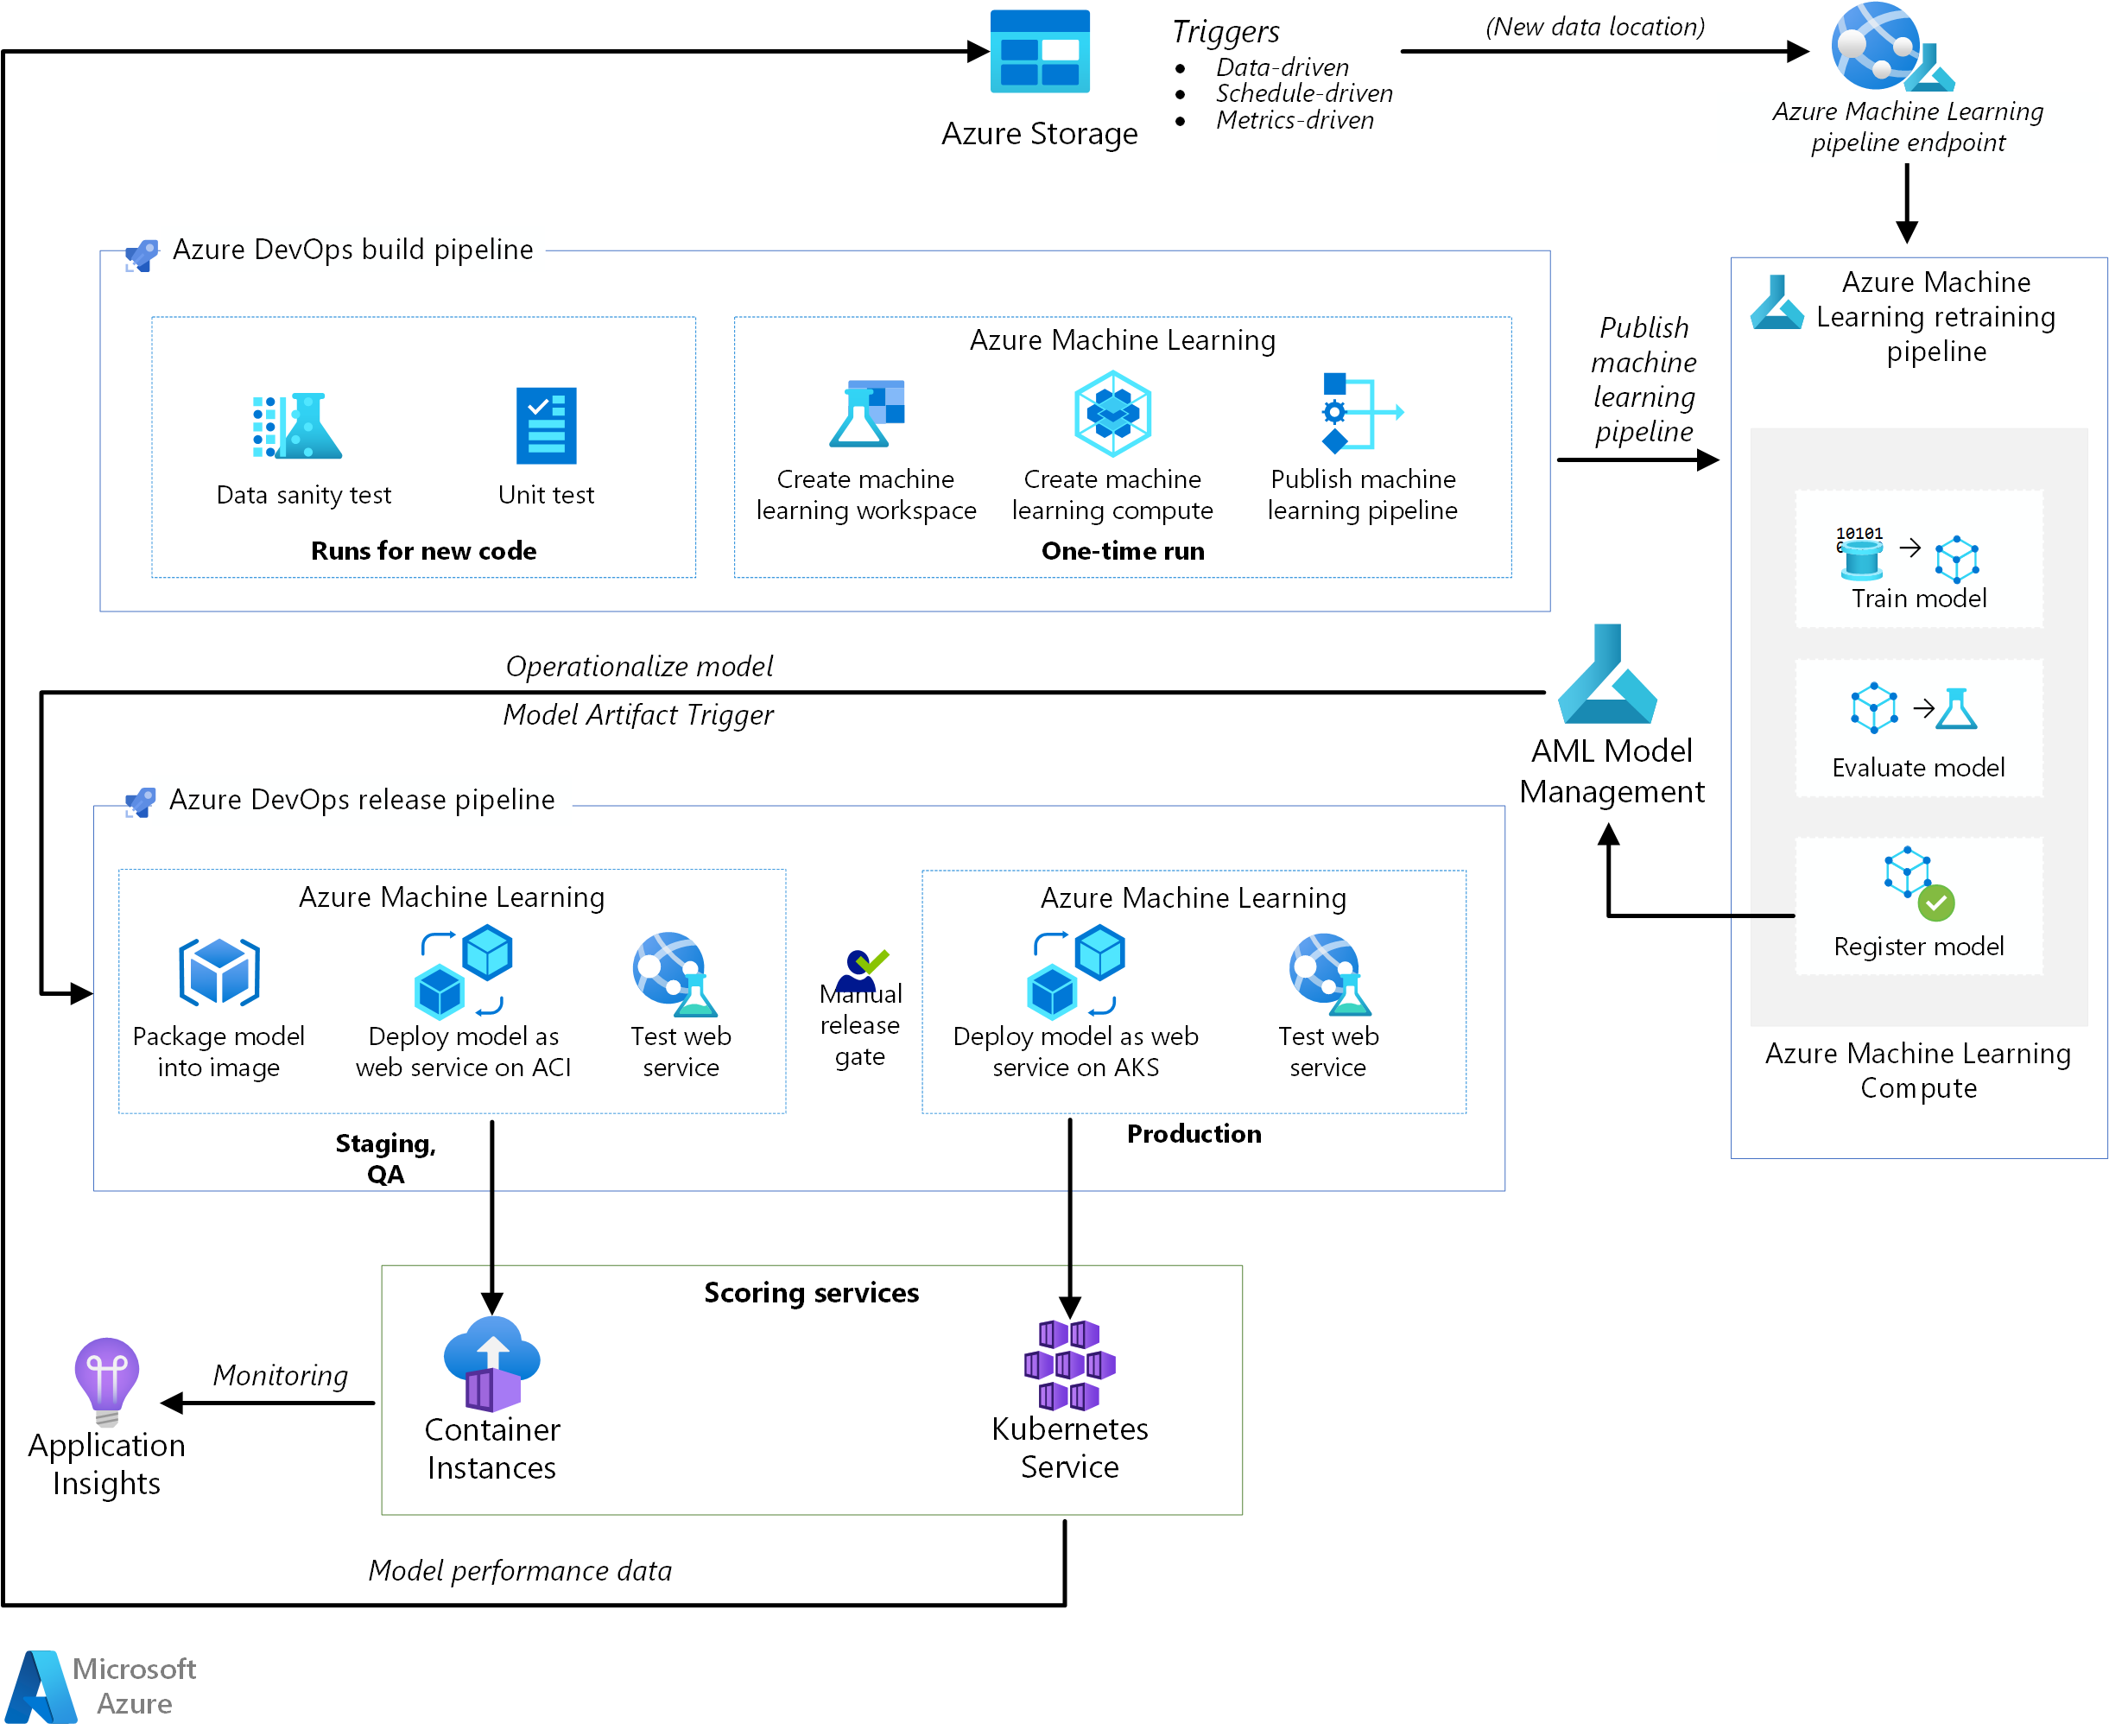
Machine Learning Architecture - Azure
Architecture MLOPs for Azure

Slide 13
Applications of Machine Learning
To be continued !

